Slide 1
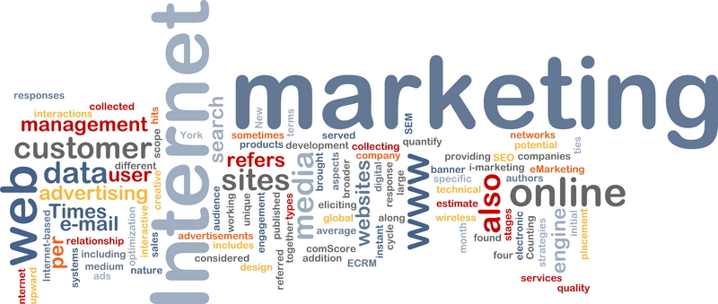
'Category O' Dashboards and Final Analysis
Inez Gunawan, Saier (Sam) Hu, Yiru Lin, Brody Patterson, Kenny Wang

Slide 2

Purpose of Dashboard 1
Dashboard 1 is specifically for C-level executives who are interested in the long-term success of the business. By utilizing Dashboard 1, C-level executives should be able to gain a high-level understanding of the most important marketing and sales metrics related to the category of interest.
C-level executives should be able to quickly comprehend the metrics included in Dashboard 1 without any outside assistance, but if questions related to a metric do arise, marketing managers should be able to respond to such questions quickly and concisely.
Notes:
Kenny to add more metrics into this

Slide 3

Purpose of Dashboard 2
Dashboard 2 is specifically for marketing managers who are interested in both the short-term and long-term success of the business. By utilizing Dashboard 2, marketing managers should be able to gain an in-depth understanding of how marketing and sales are acting across the category of interest.
Additionally, by utilizing Dashboard 2, marketing managers should be able extrapolate key factors impacting category sales, which will allow them to respond quickly to optimize category sales and other key business operations.
Notes:
Kenny to add more metrics into this

Slide 4
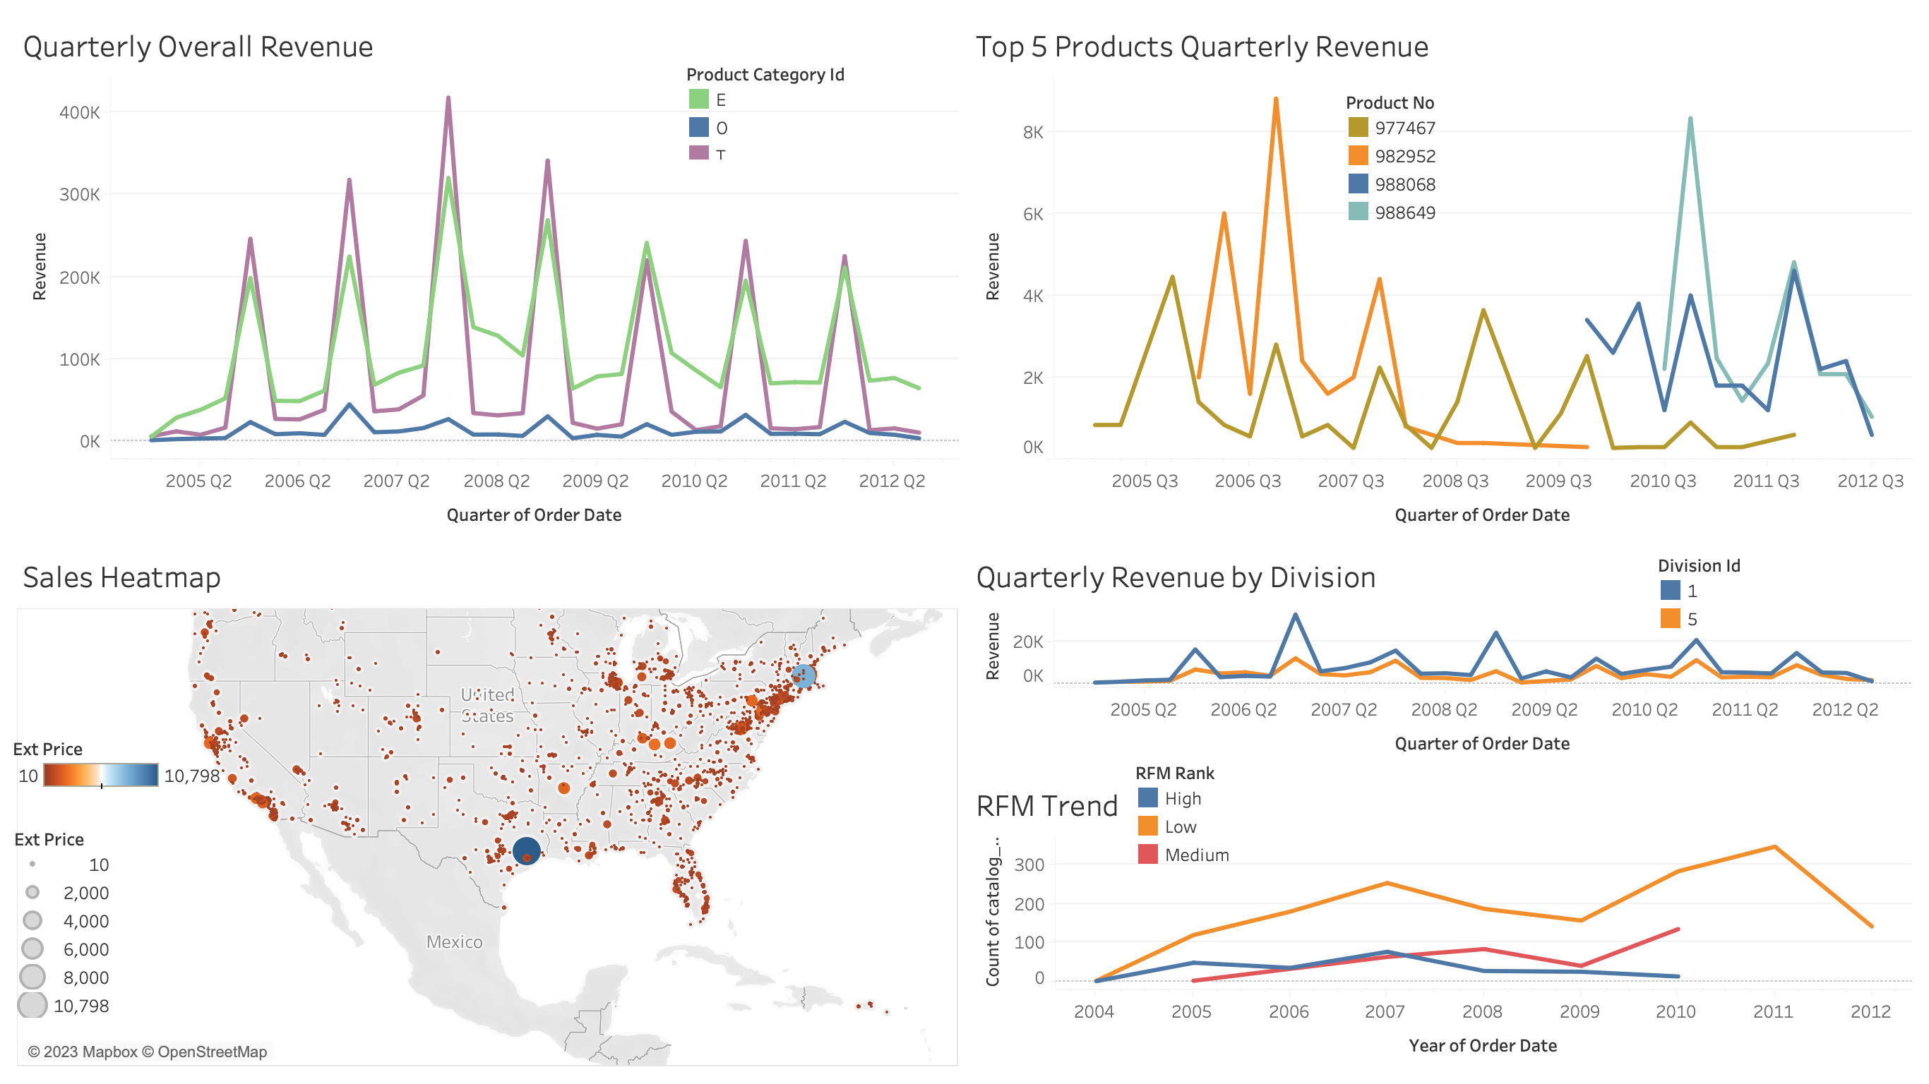
Dashboard 1
Why these metrics?
(1) Increase sales
-> benchmark
-> identify successful products
-> gauge divisional performance
-> understand disparity in sales in different geographical markets
(2) Gain high RFM ranking customers
-> reverse trend of losing high RFM ranking customers
Notes:
Kenny to add more metrics into this

Slide 5
Dashboard 1 Metrics – For C-level Executives
Overall Category Revenue (Quarterly)
Top 5 Products with Highest Sales (Quarterly)
See how the category is performing over time compared to benchmark categories, such as sales leader category T and E
-> If sales patterns of category O do not follow benchmark patterns at some quarters, executives should diagnose potential causes of missed growth opportunities (e.g. 2006 Q2) to avoid future mistakes
Identify which product(s) drive the most sales in the category
-> Executives can allocate resources to these products within the category to boost growth
Customers by RFM Score (Yearly)
Visualize the customer behaviors over the years
-> Executive can pinpoint years when higher RFM ranking customers were lost and identify causes (e.g. 2008)
Sales by Division ID (Quarterly)
Understand which of the 2 divisions is performing better in terms of sales
-> If a division is not performing well, executives should evaluate the long-term viability of that division
Sales Heat Map (Overall)
Allows executives to see a visual of sales by geographic region
-> Executives can target specific geographic regions: develop small / new markets and retain lucrative markets (e.g. 77304, Texas)
Notes:
Kenny to add more metrics into this
Goals and Strategy • Examine Measures – What measures should we focus on? • Monitor – At what levels of a measure should we worry? • Systems & Support

Slide 6
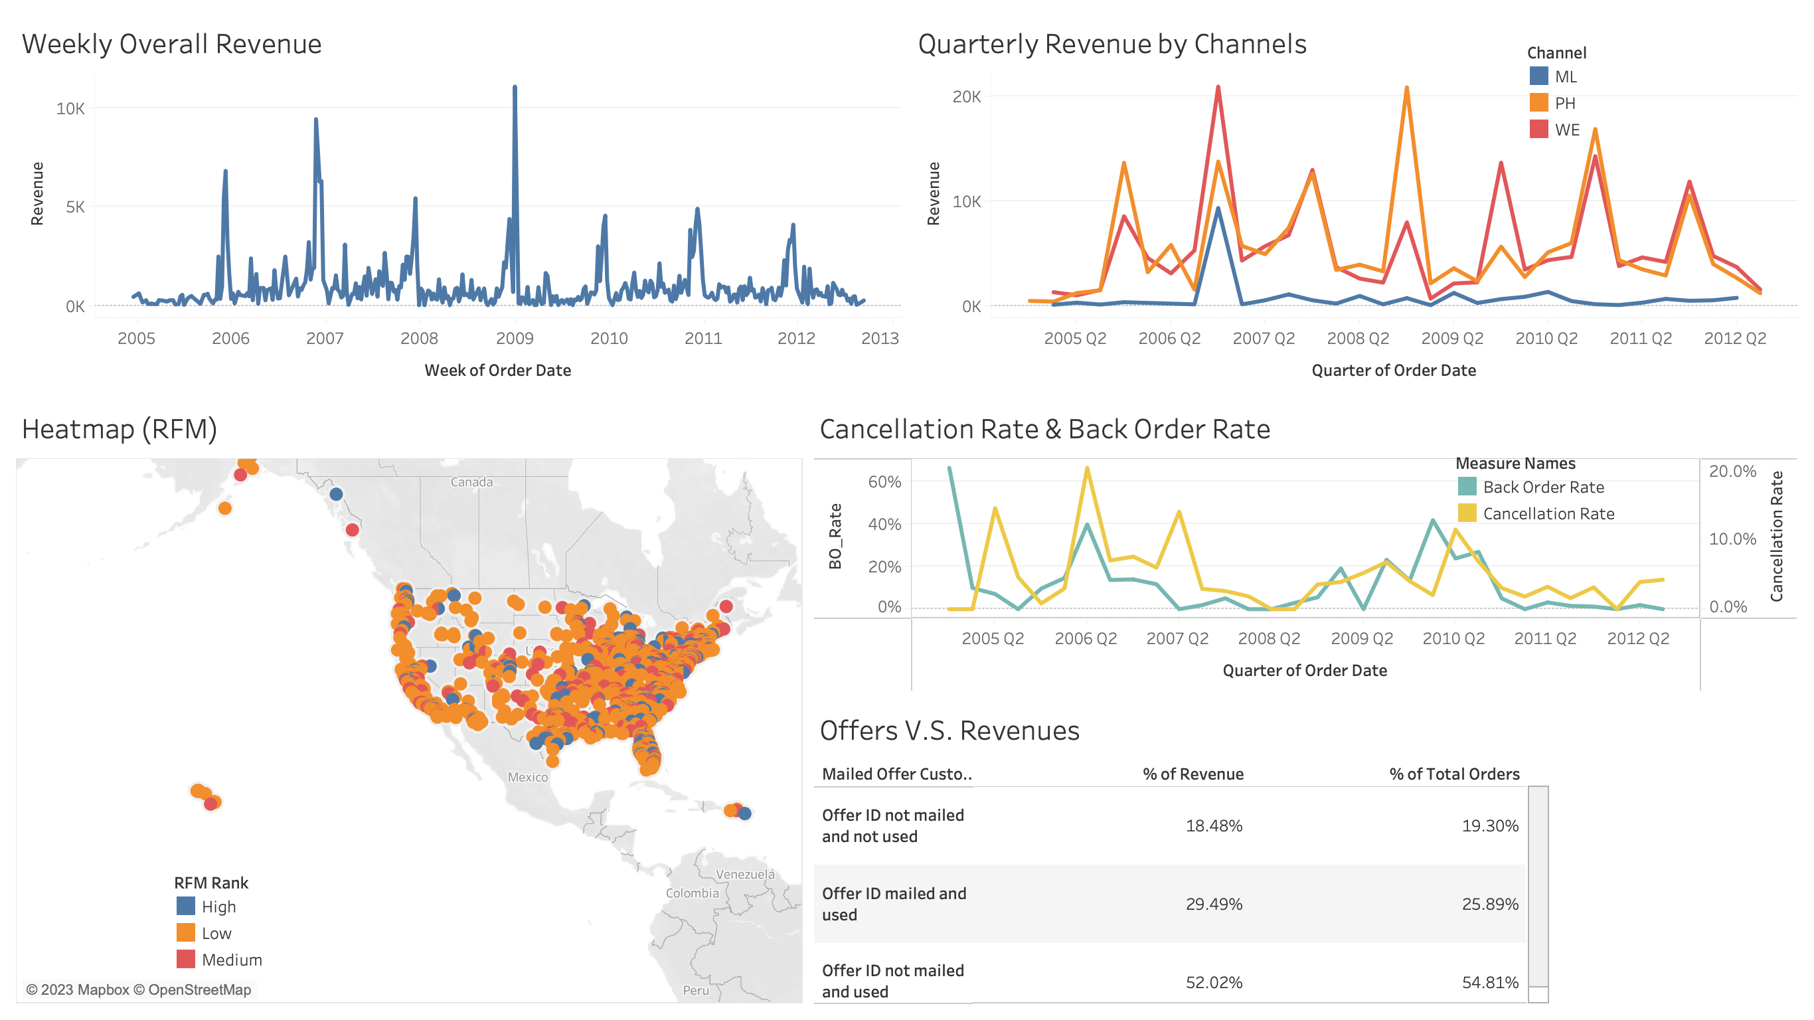
Dashboard 2
Why these metrics?​
(1) Increase sales​
-> analyze reasons behind peak weeks in sales
-> evaluate effectiveness of different channel on sales
-> understand if back orders affect sales negatively
-> gauge impact of offers on sales
​
(2) Few high RFM ranking customers​
-> identify and retain high-value customers​ in specific geographical locations
​
Notes:
Kenny to add more metrics into this

Slide 7
Dashboard 2 Metrics – For Marketing Managers
Overall Category Revenue (Weekly)
Cancellation and Back Order Rates (Quarterly)
See if sales for a particular week (or holidays) are better or worse than previous years
-> Marketing managers can utilize this short-term revenue information to create campaigns and marketing strategies accordingly
Determine if there is a correlation between cancellations and back orders
-> The back-order rate and cancellation rate follow extremely similar patterns. Thus, managers should better manage supply chain to minimize backorders and maximize sales (since back orders are likely to be cancelled)
Revenue by Channel (Quarterly)
Examine which channels account for the majority of sales revenue
-> Managers can differentiate advertising budget in different channels to maximize ROI (in this case, minimize mail campaigns)
Offer Use as % of Total Revenue and Orders
Find out if offers incentivize purchases
-> We can observe that regardless of offers are mailed or not, purchases associated with offers constitute more than 82% of total sales and 77% of total orders. Thus, (a) marketing managers should ensure as many customers have knowledge of / access to offers; (b) this shows mail campaigns are ineffective and should be minimized
RFM Rank by Zip Code Heat Map
Understand the pattern of customer behaviors in different geographic locations
-> Managers can then determine target customer personas and design marketing campaigns and sales strategy around this; develop low RFM ranking customers, retain high RFM ranking customers
Notes:
Kenny to add more metrics into this
Goals and Strategy • Examine Measures – What measures should we focus on? • Monitor – At what levels of a measure should we worry? • Systems & Support

Slide 8
Metric Interpretations
Dashboard 1 Metrics
The metrics included in Dashboard 1 come together to tell the high-level story of Category O's sales and customers over medium-to-long time horizons (quarterly, yearly).
Each metric was carefully selected to assist in telling this story. Overall revenue as well as revenue sorted by product, division, and geographic region are encompassed in this dashboard. Additionally, customer RFM scores are included in this dashboard, but only at a high level that is meaningful to executives.
C-level executives can utilize Dashboard 1 to help make resource allocation decisions, and they can ask more in-depth questions if they see trends of interest (i.e. overall sales declining).
Dashboard 2 Metrics
The metrics included in Dashboard 2 come together to tell a more in-depth story of Category O's sales, internal-facing operations, and customers over short-to-medium time horizons (weekly, quarterly).
Each metric was carefully selected to assist in telling this story. The weekly revenue and quarterly revenue by channel metrics help shape the bigger picture, while the cancellation/back orders and offer/revenue metrics tell a bit more about how Category O is functioning internally. Additionally, customer RFM scores are included but at a geographic level this time.
Marketing managers can utilize Dashboard 2 to assist in making short-term marketing decisions that require more immediate data related to category performance, as well as short-term operational decisions such as offer allocation.
Notes:
Kenny to add more metrics into this

Slide 9



Refresh Cadence
(Dashboard Updates)
C-Level Dashboard
(Dashboard 1)
Middle Management Dashboard
(Dashboard 2)
Focus on high-level KPIs that provide an overview of the category's performance, including comparisons to other categories.
We suggest updating the dashboard's metrics monthly or quarterly, depending on the metric and data availability.
Focus on more granular metrics that provide insights into specific areas of the business.
We suggest updating the dashboard weekly (as data permits), with the intent that marketing managers use the dashboard to drive business decisions such as marketing and product emphasis.
Notes:
e) How frequently would you update the dashboard? (Kenny)
The frequency of updates for these dashboards will depend on the nature of the business and the purpose of the dashboard, as well as the availability of data.
For an executive dashboard, we want to focus on high-level KPIs that provide an overview of the company's performance. Therefore, we suggest updating the executive dashboard monthly or quarterly.
For a middle management dashboard, we want to focus on more granular metrics that provide insights into specific areas of the business. We suggest updating the middle management dashboard weekly or bi-weekly.
It's important to strike a balance between updating the dashboard frequently enough to reflect the most recent data, but not so frequently that it becomes a burden to maintain.

Slide 10







Dashboard Limitations (Tradeoffs/Drawbacks)
Breadth and Depth of Data
“Garbage in, Garbage out”
Overemphasis on metrics
Notes:
f) What are some tradeoffs/ drawbacks of the dashboard, as you can't possibly include every piece of information (Kenny)
Breadth and Depth of Data: the dashboards provide a high-level overview of performance, which means that they can't include every granular detail. This can be a drawback if we need more detailed information to make informed decisions.
“Garbage in, Garbage out”: dashboards are only as good as the data that is fed into them. If data quality is poor, the dashboard may provide inaccurate or misleading information.
Overemphasis on metrics: dashboards can lead to an overemphasis on metrics at the expense of other qualitative factors such as customer feedback, employee morale, or market trends.

